Slide 1

Recommendation system
SHASHANK.L.H PES1UG21CS557
SHREYAS.B PES1UG21CS579
SOURABHA.G PES1UG21CS608
SHRI GANESH PES1UG21CS612

Slide 2
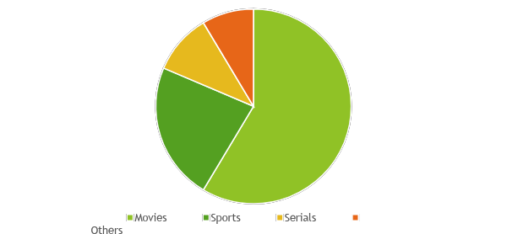
What is it?
Recommendation systems are a way of suggesting like or similar items and ideas to a users specific way of thinking.

Slide 3






Where it is used ?

Slide 4
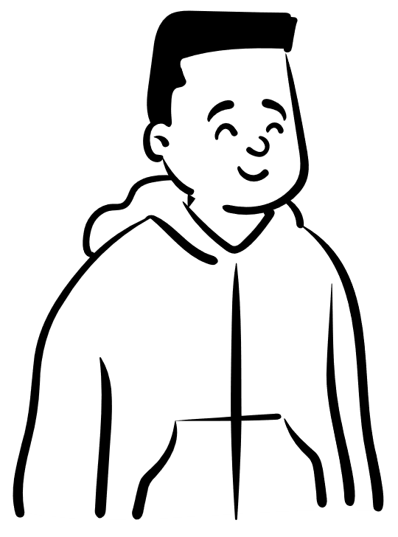





Example:
Shubman
Sara

Slide 5
Types of Recommendation System
Recommendation system
Content-Based filtering
Collaborative filtering

Slide 6
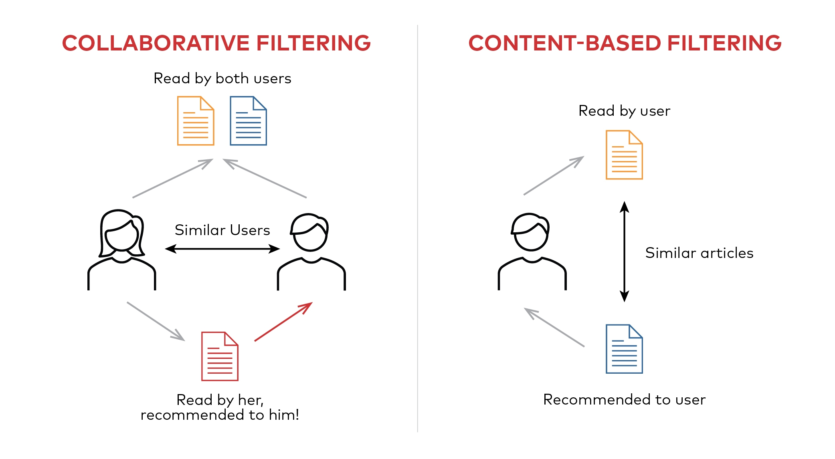

Slide 7
Disadvantages
The ‘cold start’ problem
Inability to capture changes in user behavior
Lack of Data
Inactive participation of the users in surveys
Changing Data

Slide 8
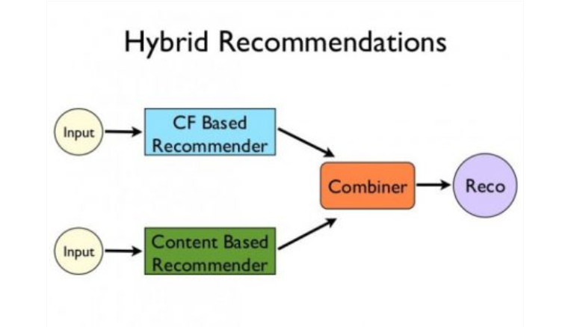
Solution to these problems…
Hybrid RS
The hybrid recommendation system is a special type of system that used data of both collaborative data and content-based data simultaneously which helps to suggest a similar or close item to the users. Combining the two above approaches helps to resolve the big problems in more effective cases sometimes. In this, the system suggests similar items which are already used by the user or suggests the items which are likely to be used by another user with some similarities.

Slide 9





Lets Understand How it works…

Slide 10





Netflix ratings
 | M1 | M2 | M3 | M4 | M5
 | 1 | 3 | 2 | 5 | 4
 | 2 | 1 | 1 | 1 | 5
 | 3 | 2 | 3 | 1 | 5
 | 2 | 4 | 1 | 5 | 2

Slide 11




Types of Peoples:
Group 1
Group 2
Group 3

Slide 12
How do humans behave ?
 | M1 | M2 | M3 | M4 | M5
 | 3 | 3 | 3 | 3 | 3
 | 3 | 3 | 3 | 3 | 3
 | 3 | 3 | 3 | 3 | 3
 | 3 | 3 | 3 | 3 | 3
 | M1 | M2 | M3 | M4 | M5
 | 1 | 3 | 2 | 5 | 4
 | 2 | 1 | 1 | 1 | 5
 | 3 | 2 | 3 | 1 | 5
 | 2 | 4 | 1 | 5 | 2
 | M1 | M2 | M3 | M4 | M5
 | 3 | 1 | 1 | 3 | 1
 | 1 | 2 | 4 | 1 | 3
 | 3 | 1 | 1 | 3 | 1
 | 4 | 3 | 5 | 4 | 4

Slide 13
Dependent Rows and Columns
 | M1 | M2 | M3 | M4 | M5
 | 3 | 1 | 1 | 3 | 1
 | 1 | 2 | 4 | 1 | 3
 | 3 | 1 | 1 | 3 | 1
 | 4 | 3 | 5 | 4 | 4
I love action and comedy movies !
+
=
I love action movies !
I love comedy !

Slide 14
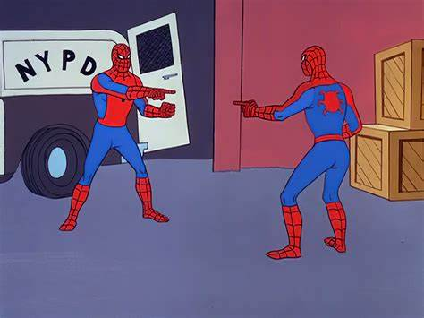

How machine treats user 1 & 33
How machine treats user 4

Slide 15
Q: How do we figure out all these depedencencies ?

Slide 16
Concept of matrix factorization

Slide 17
Matrix Factorization
 | comedy | action
M1 | 3 | 1
M2 | 1 | 2
M3 | 1 | 4
M4 | 3 | 1
M5 | 1 | 3
 | comedy | action
 | 1 | 0
 | 0 | 1
 | 1 | 0
 | 1 | 1
 | M1 | M2 | M3 | M4 | M5
 | 3 | 1 | 1 | 3 | 1
 | 1 | 2 | 4 | 1 | 3
 | 3 | 1 | 1 | 3 | 1
 | 4 | 3 | 5 | 4 | 4
=

Slide 18
Uses: Storage
More Space
Less Space
comedy
action

Slide 19


Let’s take example:
Without Factorization
720 CSE students
With Factorization
720 CSE students with 100 features
720 X 720 =5,18,400
720 X 100 =72000
(with 100 features)
100X100=10,000
72,000 +10,000=82,000

Slide 20

Can you think of it !
4.9Billion X 4.9Billion

Slide 21

Let’s Understand Error function

Slide 22

F1 | 1.2 | 3.1 | 0.3 | 2.5 | 0.2
F2 | 2.4 | 1.5 | 4.4 | 0.4 | 1.1
 | comedy | action
 | 0.2 | 0.5
 | 0.3 | 0.4
 | 0.7 | 0.8
 | 0.4 | 0.5
 | M1 | M2 | M3 | M4 | M5
 | 1.44 | 1.37 | 2.26 | 0.7 | 0.59
 | 1.32 | 1.53 | 1.85 | 0.91 | 0.5
 | 2.76 | 3.37 | 3.37 | 2.07 | 1.02
 | 1.68 | 1.99 | 2.32 | 1.2 | 0.63

Slide 23
Let’s Compare
 | M1 | M2 | M3 | M4 | M5
 | 1.44 | 1.37 | 2.26 | 0.7 | 0.59
 | 1.32 | 1.53 | 1.85 | 0.91 | 0.5
 | 2.76 | 3.37 | 3.37 | 2.07 | 1.02
 | 1.68 | 1.99 | 2.32 | 1.2 | 0.63
 | M1 | M2 | M3 | M4 | M5
 | 3 | 1 | 1 | 3 | 1
 | 1 | 2 | 4 | 1 | 3
 | 3 | 1 | 1 | 3 | 1
 | 4 | 3 | 3 | 4 | 4
This leads to error function…

Slide 24
Error Function
 | M1 | M2 | M3 | M4 | M5
 | 1.44 | 1.37 | 2.26 | 0.7 | 0.59
 | 1.32 | 1.53 | 1.85 | 0.91 | 0.5
 | 2.76 | 3.37 | 3.37 | 2.07 | 1.02
 | 1.68 | 1.99 | 2.32 | 1.2 | 0.63
 | M1 | M2 | M3 | M4 | M5
 | 3 | 1 | 1 | 3 | 1
 | 1 | 2 | 4 | 1 | 3
 | 3 | 1 | 1 | 3 | 1
 | 4 | 3 | 3 | 4 | 4
The Sum of Square of difference between the actual value and obtained value is called as Error function.
The Derivative of the error function tells us how much to increase or decrease the features or other parameters . e

Slide 25
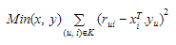
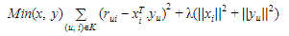
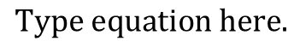
Equations used…
each item be represented by a vector xi & each user is represented by a vector yu.
dot product gives the expected rating
The xi and yu can be obtained in a manner that the square error difference between their dot product and the expected rating in the user-item matrix is minimum.

Slide 26
Continued…
In order to let the model generalise well and not overfit the training data, a regularisation term is added as a penalty to the above formula.
In order to reduce the error between the value predicted by the model and the actual value, the algorithm uses a bias term.
This equation is the main component of the algorithm which works for singular value decomposition based recommendation system.

Slide 27

Concept of SVD
Singular Value Decomposition:-
The Singular Value Decomposition (SVD), a method from linear algebra that has been generally used as a dimensionality reduction technique in machine learning
In the context of the recommender system, the SVD is used as a collaborative filtering technique.
It also a type of MATRIX FACTORIZATION TECHNIQUE
It uses a matrix structure where each row represents a user, and each column represents an item. The elements of this matrix are the ratings that are given to items by users.
The singular value decomposition is a method of decomposing a matrix into three other matrices .
Where A is a m x n utility matrix.
U is a m x r orthogonal left singular matrix, which represents the relationship between users and latent factors. It is a user space.
S is a r x r diagonal matrix, which describes the strength of each latent factor .

Slide 28
Singular Value Decomposition(Continued)
V is a r x n diagonal right singular matrix, which indicates the similarity between items and latent factors. It is a item space V
The latent factors here are the characteristics of the items, for example, the genre of the music.
The SVD decreases the dimension of the utility matrix A by extracting its latent factors.
It maps each user and each item into a r-dimensional latent space. This mapping facilitates a clear representation of relationships between users and items .x n diagonal right singular matrix, which indicates the similarity between items and latent factors.

Slide 29
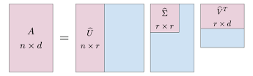
GRAPHICAL REPRESENTATION OF SVD
DIMENSIONALITY REDUCTION

Slide 30

Code:
import numpy as np
from scipy.linalg import svd
# Generate temporary data
matrix = np.array([[5, 3, 0, 1,], [4, 0, 0, 1], [ 1, 1, 0, 5], [1, 0, 0, 4], [0, 1, 5, 4]])
items = ['item1', 'item2', 'item3', 'item4']
print("Original matrix:\n" ,matrix)
U, S, V = svd(matrix, full_matrices=False)
k = 3 #key features to keep/ reduced dimensions
print("\nU:-",U)
print("\nS:-",S)
print("\nV:-",V)

Slide 31
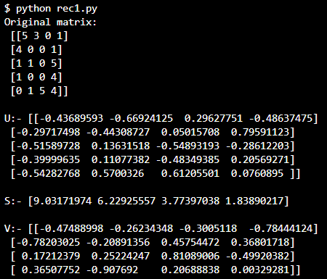

Slide 32
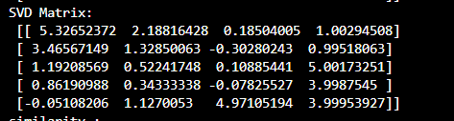
matrix_svd = U[:, :k] @ np.diag(S[:k]) @ V[:k, :]
print("SVD Matrix:\n", matrix_svd)

Slide 33
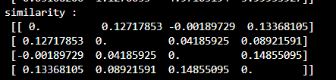
def item_similarity(matrix):
similarity = np.dot(matrix.T,matrix)/(norm(matrix.T)*norm(matrix))
np.fill_diagonal(similarity, 0)
return similarity
similarity_svd = item_similarity(matrix_svd)
print("similarity :\n",similarity_svd)
Here we are using cosine similarity to find the similarity between the items.

Slide 34
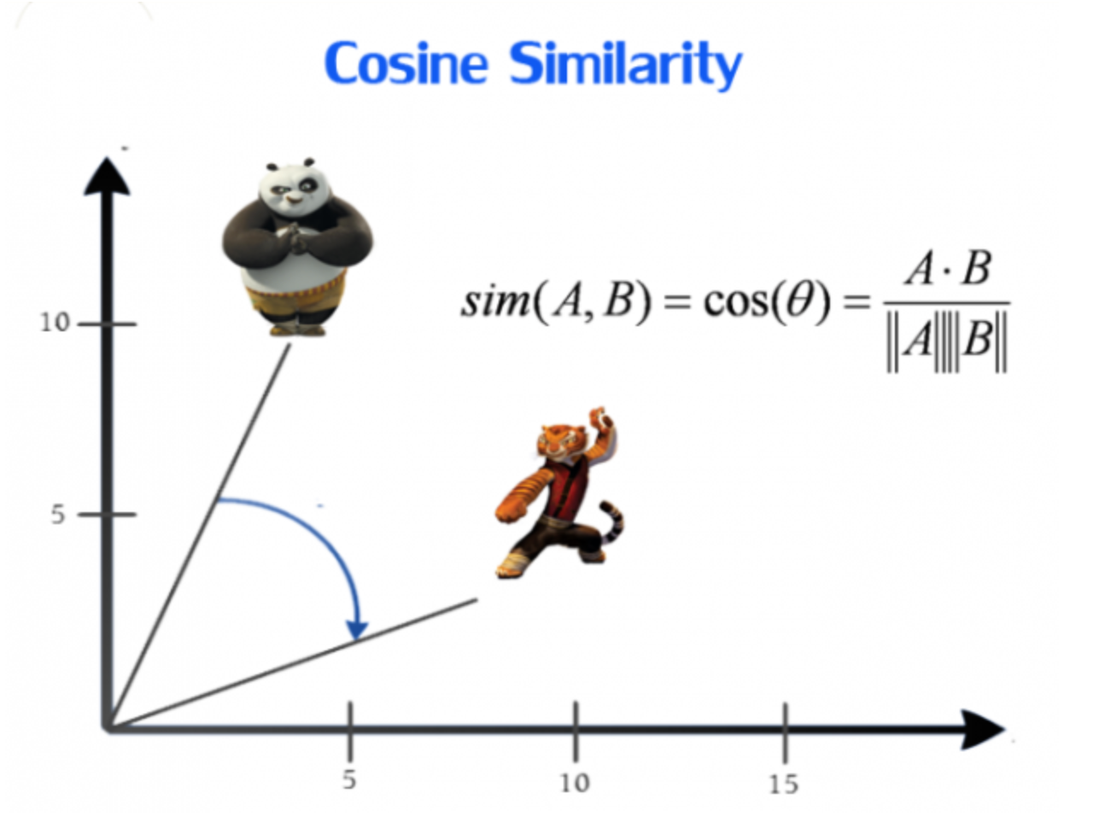
Cosine Similarity
Cosine similarity is a measure of similarity between two non-zero vectors of an inner product space that measures the cosine of the angle between them.
The cosine similarity between two vectors A and B is calculated as the dot product of A and B divided by the product of the magnitudes of A and B.
The resulting value ranges from -1 to 1, with 1 indicating that the two vectors are identical and -1 indicating that they are completely dissimilar.

Slide 35
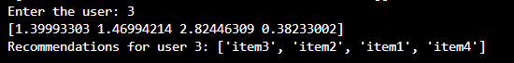
def recommend(user, matrix, similarity, items):
user_index = user - 1
user_ratings = matrix[user_index, :]
item_scores = np.zeros((matrix.shape[1],))
for item in range(matrix.shape[1]):
item_sum = 0
for other_item in range(matrix.shape[1]):
if user_ratings[other_item] == 0 or similarity[item][other_item] == 0:
continue
item_sum = user_ratings[other_item] * similarity[item][other_item]
item_scores[item] = item_sum / np.abs(similarity[item]).sum()
recommendations = [items[i] for i in np.argsort(item_scores)[::-1]]
print(item_scores)
return recommendations
n=int(input("Enter the user: "))
user =n
recommendations = recommend(user, matrix, similarity_svd, items)
print(f"Recommendations for user {user}: {recommendations}")

Slide 36



Resources
https://analyticsindiamag.com/singular-value-decomposition-svd-application-recommender-system/
https://journalofbigdata.springeropen.com/articles/10.1186/s40537-022-00592-5
https://jaketae.github.io/study/svd/

Slide 37



